Slide 1

Mathematical Induction
There are two aspects of mathematics, discovery and proof.
Both are of equal importance.
We must discover something before we can attempt to prove it.
We can only be certain of its truth once it has been proved.

Slide 2
Mathematical Induction
In this lecture, we examine the relationship between these two key components of mathematics more closely.

Slide 3

Discovery and Proof
Let’s try a simple experiment.
We add more and more of the odd numbers as follows: 1 = 1 1 + 3 = 4 1 + 3 + 5 = 9 1 + 3 + 5 + 7 = 16 1 + 3 + 5 + 7 + 9 = 25
What do you notice about the numbers on the right side of these equations?

Slide 4
Discovery and Proof
This leads naturally to the following question:
Is it true that, for every natural number n, the sum of the first n odd numbers is n²?
Could this remarkable property be true?

Slide 5
Discovery and Proof
They are, in fact, all perfect squares.
These equations say:
The sum of the first 1 odd number is 1².
The sum of the first 2 odd numbers is 2².
The sum of the first 3 odd numbers is 3².
The sum of the first 4 odd numbers is 4².
The sum of the first 5 odd numbers is 5².

Slide 6
Discovery
At this point, we feel quite sure that this is always true.
So, we make a discovery: The sum of the first n odd numbers is n².

Slide 7
Discovery
Since we know that the nth odd number is 2n – 1, we can write this statement more precisely as: 1 + 3 + 5 + . . . + (2n – 1) = n²
It’s important to realize that this is still a discovery.
We cannot conclude by checking a finite number of cases that a property is true for all numbers (there are infinitely many).

Slide 8
Discovery
Let’s see this more clearly.
Suppose someone tells us he has added up the first trillion odd numbers and found that they do not add up to 1 trillion squared.
What would we tell this person?

Slide 9
Discovery
It would be silly to say that we’re sure it’s true because we’ve already checked the first five cases.
We could, however, take out paper and pencil and start checking it ourself.
(This would probably take the rest of our life.)

Slide 10
Proof
Herein lies the power of mathematical proof.
A proof is a clear argument that demonstrates the truth of a statement beyond doubt.

Slide 11
Mathematical Induction
Let’s consider a special kind of proof called mathematical induction.
Now, let’s see how it works.

Slide 12
Mathematical Induction
Suppose we have a statement that says something about all-natural numbers n.
Let’s call this statement P.
For example, P: For every natural number n, the sum of the first n odd numbers is n².

Slide 13
Mathematical Induction
Since this statement is about all natural numbers, it contains infinitely many statements.
We will call them P(1), P(2), . . . . P(1): The sum of the first 1 odd number is 1². P(2): The sum of the first 2 odd numbers is 2². P(3): The sum of the first 3 odd numbers is 3².

Slide 14
Mathematical Induction
How can we prove all of these statements at once?
Mathematical induction is a clever way of doing so.

Slide 15
Mathematical Induction
The core of the idea is:
Suppose we can prove that, whenever one of these statements is true(Making assumption), then the one following it in the list is also true(Have to proof this).
That is, For every k, if P(k) is true, then P(k + 1) is true
This is called the induction steps since it leads us from the truth of one statement to the next.

Slide 16
Mathematical Induction Steps
Step 1:
Proof for 1st element
Step 2 :
Making Discovery/Assumption
Step 3:
Proofing something based on assumption
Step 4 :
Conclude the Induction

Slide 17
Mathematical Induction
Now, suppose that we can also prove that P(1) is true.
The induction step now leads us through the following chain of statements.
P(1) is true, so P(2) is true. P(2) is true, so P(3) is true. P(3) is true, so P(4) is true. . .

Slide 18
Mathematical Induction
The following is a summary of this important method of proof.
So, we see that, if all the induction steps are proved, then statement P is proved for all n.

Slide 19
Mathematical Induction
For each natural number n, let P(n) be a statement depending on n.
Suppose that these conditions are satisfied.
P(1) is true.
Assumption: For every natural number k, if P(k) is true,
Have to Proof: then P(k + 1) is true.
Then, P(n) is true for all-natural numbers n.

Slide 20
Mathematical Induction
In step 2 , we do not prove that P(k) is true.
We only show that, if P(k) is true, then P(k + 1) is also true.
The assumption that P(k) is true is called the induction hypothesis.

Slide 21
A Proof by Mathematical Induction : Example 1
Prove that, for all-natural numbers n,1 + 3 + 5 + . . . + (2n – 1) = n²
Let P(n) denote the statement.

Slide 22
A Proof by Mathematical Induction : Example 1 – Step 1
We need to show that P(1) is true.
However, P(1) is simply the statement that 1 = 1².
This is, of course, true.

Slide 23
A Proof by Mathematical Induction : Example 1 – Step 2
Prove that, for all-natural numbers n,1 + 3 + 5 + . . . + (2n – 1) = n²
We assume that P(k) is true.
Thus, our induction hypothesis is: 1 + 3 + 5 + . . . + (2k – 1) = k²

Slide 24
A Proof by Mathematical Induction : Example 1 – Step 3
Prove that, for all-natural numbers n,1 + 3 + 5 + . . . + (2n – 1) = n²
We want to use this to show that P(k +1) is true.
That is, 1 + 3 + 5 + . . . + (2k – 1) + [2(k + 1) – 1] = (k + 1)²
Note that we get P(k + 1) by substituting k + 1 for each n in the statement P(n).

Slide 25
A Proof by Mathematical Induction : Example 1 – Step 3
We start with the left side and use the induction hypothesis to obtain the right side of the equation:
1 + 3 + 5 + . . . + (2k – 1) + [2(k + 1) – 1] = [1 + 3 + 5 + . . . + (2k – 1)] + [2(k + 1) – 1]
(Group the first k terms)

Slide 26
A Proof by Mathematical Induction : Example 1 – Step 3
= k² + [2(k + 1) – 1] Induction Hypothesis = k² + [2k + 2 – 1] = k² + 2k + 1 = (k + 1)²
Thus, P(k + 1) follows from P(k).
This completes the induction step.

Slide 27
A Proof by Mathematical Induction : Example 1 – Step 4
Having proved steps 1, 2 and 3, we conclude by the Principle of Mathematical Induction that P(n) is true for all-natural numbers n.

Slide 28
A Proof by Mathematical Induction : Example 2
Prove that, for every natural number n,
Let P(n) be the statement.
We want to show that P(n) is true for all-natural numbers n.

Slide 29
A Proof by Mathematical Induction : Example 2 – Step 1
We need to show that P(1) is true.
However, P(1) says that:
P(1) is simply the statement that 1 = 1(1+1)/2
1=1
This statement is clearly true.

Slide 30
A Proof by Mathematical Induction : A Proof A Proof by Mathematical Induction : Example 1 – Step 2
Assume that P(k) is true.
Thus, our induction hypothesis is:
We want to use this to show that P(k + 1) is true.
That is,

Slide 31
Proof by Mathematical Induction : Example 1 – Step 3
So, we start with the left side and use the induction hypothesis to obtain the right side: 1 + 2 + 3 + . . . + k + (k + 1) = [1 + 2 + 3 + . . . + k] + (k + 1)

Slide 32
Proof by Mathematical Induction : Example 1 – Step 2
Thus, P(k + 1) follows from P(k).
This completes the induction step

Slide 33
Proof by Mathematical Induction : Example 1 – Step 4
Having proved Steps 1, 2, and 3 we conclude by the Principle of Mathematical Induction that P(n) is true for all-natural numbers n.

Slide 34
Mathematical Induction
It might happen that a statement P(n) is false for the first few natural numbers, but true from some number on.
For example, we may want to prove that P(n) is true for n ≥ 4.
Notice that, if we prove that P(4) is true, then this fact, together with the induction step, would imply the truth of P(5), P(6), P(7), . . . .

Slide 35
Proving an Inequality by Induction : Example 3
Prove that 2^{n} < n! for all n ≥ 4
Let P(n) denote the statement 2^{n} < n!.

Slide 36
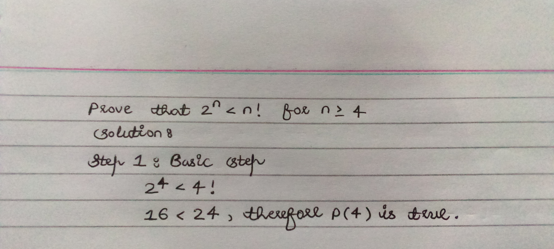
Proving an Inequality by Induction : Example 3 - Step 1

Slide 37
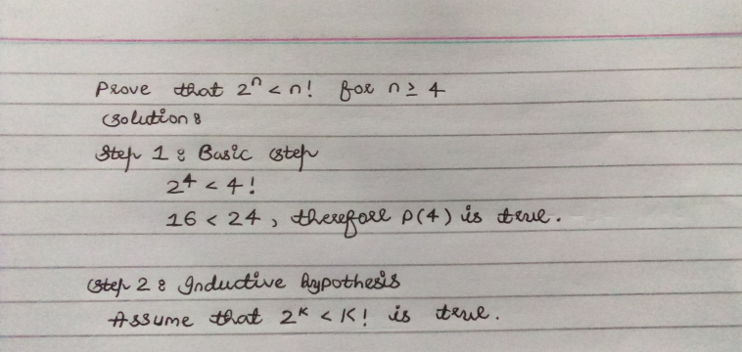
Proving an Inequality by Induction : Example 3 - Step 2

Slide 38
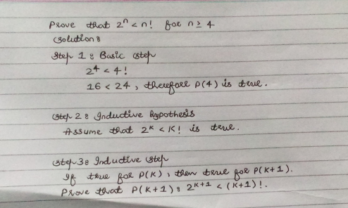
Proving an Inequality by Induction : Example 3 - Step 2

Slide 39
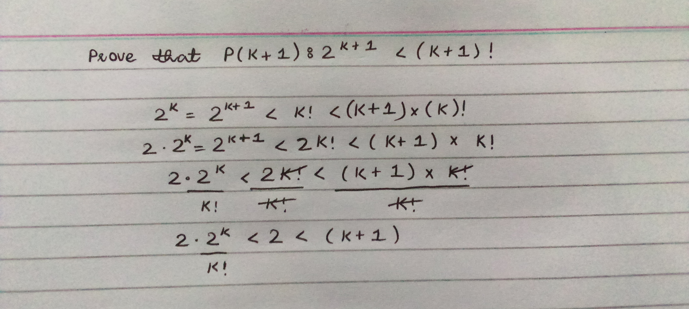
Proving an Inequality by Induction : Example 3 - Step 2

Slide 40
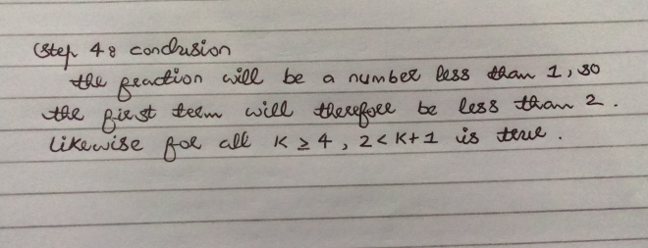
Proving an Inequality by Induction : Example 3 - Step 4

Slide 41

Probability Use in Computer Science
Speech Recognition

Slide 42

Probability Use in Computer Science
Robotics

Slide 43

Probability Use in Computer Science
Network Traffic

Slide 44

Probability
Probability : represent possibility
Definition : Probability is the likelihood (chance) of an event occurring
Basic formula :
Probability = | the number of ways of achieving success
 | the total number of possible outcomes

Slide 45
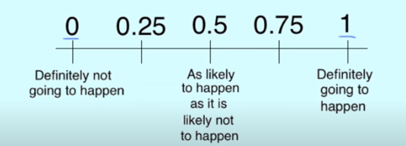
Points to Remember about Probability
The probability of an event can only be between 0 and 1 and can also be written as a percentage.
The probability of event A is often written as P(A).
If P(A) > P(B), then event A has a higher chance of occurring than event B.
If P(A) = P(B), then events A and B are equally likely to occur.

Slide 46

Basic Terminologies of Probability
Random Experiment
A random experiment is a repeatable action that results in one of a well-defined set of outcomes.

Slide 47
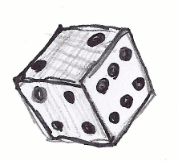
Basic Terminologies of Probability : Random Experiment – Example 1
Tossing a dice is an example of a random experiment.

Slide 48

Basic Terminologies of Probability : Random Experiment – Example 2
Another example of a random experiment is flipping a coin.

Slide 49
Basic Terminologies of Probability : Sample Size or Sample Space
We denote Sample size by capital S.
The sample space S of a random experiment is the set of all possible outcomes of the experiment.
Example
for the dice-tossing experiment S = {I, 2, 3,4,5, 6}.
For the coin-flipping experiment S = {H, T}.

Slide 50
Basic Terminologies of Probability : Event
A subset of a sample space is called an event.
Simple events are the I-element subsets of the sample space.
We denote events by capital letters.
For the dice-tossing experiment, the simple events are {I}, {2}, {3}, {4}, {5}, {6}.
Some other events in this sample space are:
An even number is rolled, E = {2,4,6}
An odd number is rolled, 0 = {I, 3, 5}

Slide 51
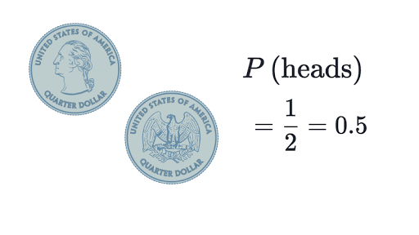
1st Example of Probability : 1 Coin Tossing
Probability of an event = (# of ways it can happen) / (total number of outcomes)

Slide 52
2nd Example of Probability : Rolling 1 Dice
There are six different outcomes.

Slide 53
2nd Example of Probability : Rolling 1 Dice
What’s the probability of rolling a one?

Slide 54
2nd Example of Probability : Rolling 1 Dice
What’s the probability of rolling a one?
Probability of an event = (# of ways it can happen) / (total number of outcomes)
P(1) = 1 / 6

Slide 55
2nd Example of Probability : Rolling 1 Dice
What’s the probability of rolling a one or a six?

Slide 56
2nd Example of Probability : Rolling 1 Dice
What’s the probability of rolling a one?
Probability of an event = (# of ways it can happen) / (total number of outcomes)
P(1 or 6) = 2 / 6
P(1 or 6) = 1 / 3

Slide 57
2nd Example of Probability : Rolling 1 Dice
What’s the probability of rolling an even number (i.e., rolling a two, four or a six)?

Slide 58
2nd Example of Probability : Rolling 1 Dice
What’s the probability of rolling a one?
Probability of an event = (# of ways it can happen) / (total number of outcomes)
P(even) = 3 / 6
P(even) = 1/ 2

Slide 59

3rd Example of Probability
There are 6 beads in a bag, 3 are red, 2 are yellow and 1 is blue. What is the probability of picking a yellow?

Slide 60
3rd Example of Probability
There are 6 beads in a bag, 3 are red, 2 are yellow and 1 is blue. What is the probability of picking a yellow?
Probability of an event = (# of ways it can happen) / (total number of outcomes)
P(yellow) = 2 / 6
P(yellow) = 1 / 3

Slide 61

4th Example of Probability
There is a bag full of colored balls, red, blue, green and orange. Balls are picked out and replaced. John did this 1000 times and obtained the following results:
Number of blue balls picked out: 300
Number of red balls: 200
Number of green balls: 450
Number of orange balls: 50
a) What is the probability of picking a green ball?

Slide 62
4th Example of Probability
There is a bag full of colored balls, red, blue, green and orange. Balls are picked out and replaced. John did this 1000 times and obtained the following results:
Number of blue balls picked out: 300
Number of red balls: 200
Number of green balls: 450
Number of orange balls: 50
What is the probability of picking a green ball?
Probability of an event = (# of ways it can happen) / (total number of outcomes)
P(green) = 450/1000 = 0.45

Slide 63
4th Example of Probability
There is a bag full of colored balls, red, blue, green and orange. Balls are picked out and replaced. John did this 1000 times and obtained the following results:
Number of blue balls picked out: 300
Number of red balls: 200
Number of green balls: 450
Number of orange balls: 50
b) If there are 100 balls in the bag, how many of them are likely to be green?

Slide 64
4th Example of Probability
There is a bag full of colored balls, red, blue, green and orange. Balls are picked out and replaced. John did this 1000 times and obtained the following results:
Number of blue balls picked out: 300
Number of red balls: 200
Number of green balls: 450
Number of orange balls: 50
b) If there are 100 balls in the bag, how many of them are likely to be green?
Probability of an event = (# of ways it can happen) / (total number of outcomes)
The experiment suggests that 450 out of 1000 balls are green. Therefore, out of 100 balls, 45 are green

